Slide 1
Panic Disorder Diagnosis
Puja Darshana Mishra
Deborupa Pal
Samantha Sanjeev
Neha Kowtharapu
FNU Amatul
Prashant

Slide 2
Introduction
People with panic disorder have frequent and unexpected panic attacks.
Every year, up to 11% of people in the United States experience a panic attack. Approximately 2% to 3% of people in the U.S. have panic disorder.
We have selected a dataset from Kaggle which has 9.4 useability about Panic Disorder Diagnosis
The Dataset has user profile which includes the following- Age, Gender, Family History, Personal History, Current Stressors, Symptoms, Severity, Impact on Life, Demographics, Medical History, Psychiatric History, Substance Abuse, Coping Mechanism, Social Support and Lifestyle Factors.
Link to dataset - Click Here

Slide 3
AIM
Develop a predictive model that can accurately predict whether an individual is likely to be diagnosed with panic disorder based on their user profile information.
HYPOTHESIS
Null Hypothesis - Panic Disorder Diagnosis is not related to Age, Gender, Family History, Personal History, Current Stressors, Symptoms, Severity, Impact on Life, Demographics, Medical History, Psychiatric History, Substance Abuse, Coping Mechanism, Social Support and Lifestyle Factors.
Alternate Hypothesis - Panic Disorder Diagnosis is related to Age, Gender, Family History, Personal History, Current Stressors, Symptoms, Severity, Impact on Life, Demographics, Medical History, Psychiatric History, Substance Abuse, Coping Mechanism, Social Support and Lifestyle Factors.

Slide 4
Purpose
Identify individuals at risk of developing panic disorder based on their user profiles.
Enable early intervention and support for individuals who may be prone to panic attacks, potentially preventing the disorder from escalating.
Tailor mental health interventions and treatment plans based on individual user profiles, taking into account factors such as demographics, lifestyle, and behavioral patterns.

Slide 5
Methodology
Data Cleaning, Extraction
Looking for missing and duplicate values
Dealing with the missing (using mode) and duplicate(keeping the first) values.
Indexing relevant column
Scaling the data
Data Visualization
Used Mat plot Lib for correlation matrix.
Plotted the count graph to understand the target column.
Box plot to visualize the numeric data vs the target variable
Used seaborn for plotting confusion matrix of the different models.
Developing Models
Logistic Regression
Random Forest
Decision Tree
XGBooster
Performing Analysis of Models
Calculating the accuracy of each model and concluding
Notes:
Correlation matrix which shows corelation coefficients between variables.

Slide 6
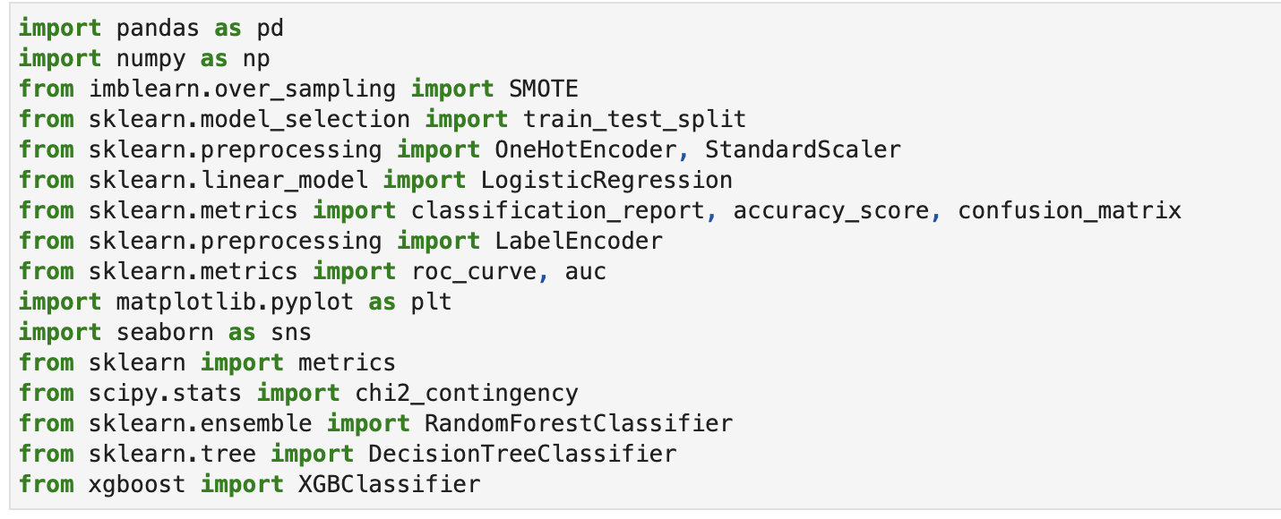
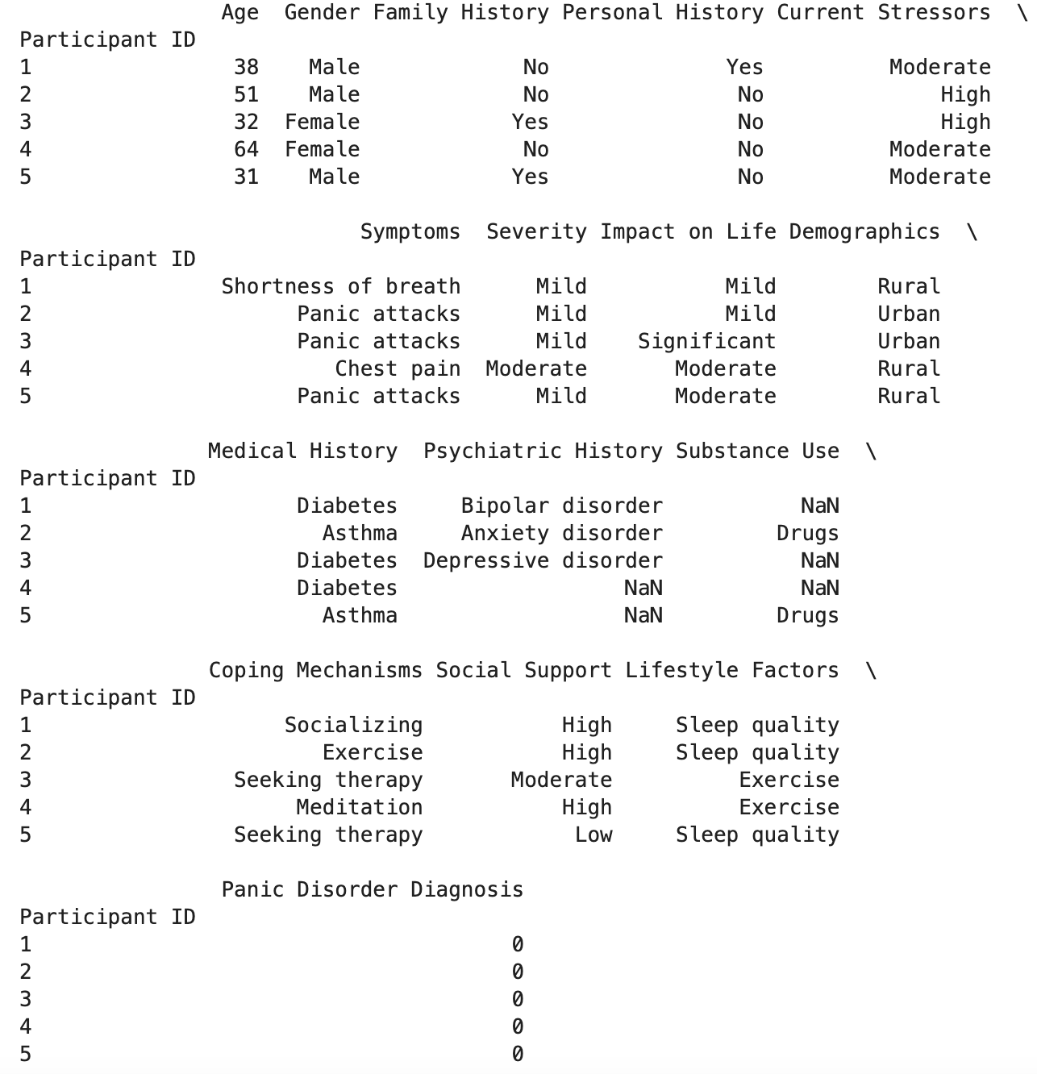
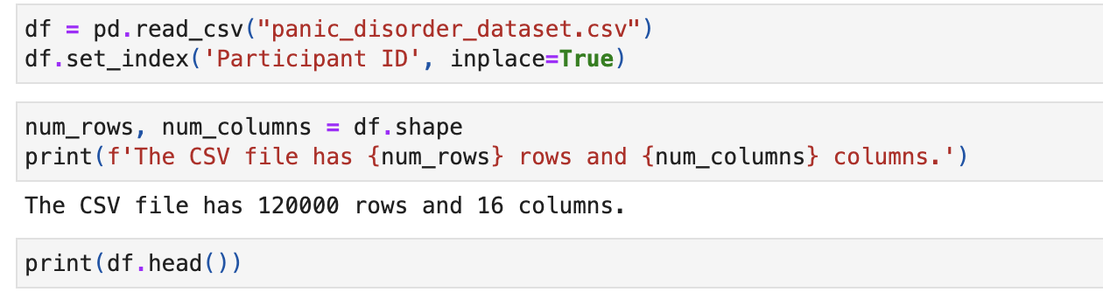
Calling all the necessary libraries
Reading the dataset

Slide 7
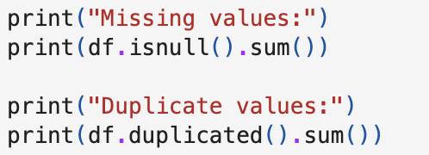
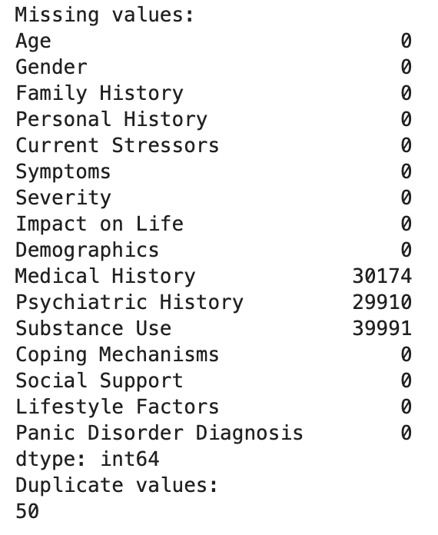
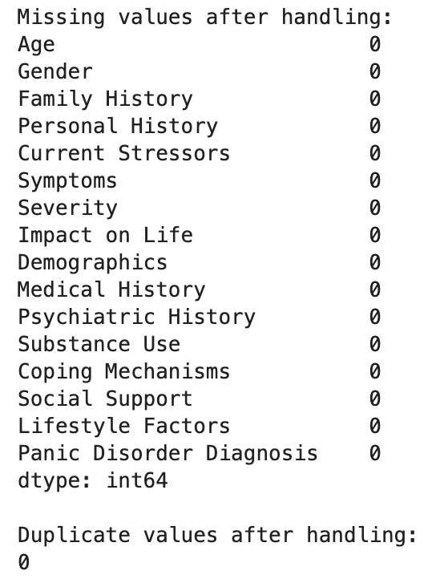
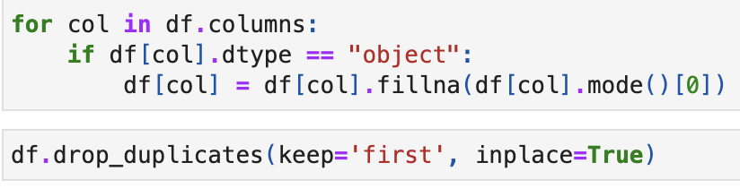
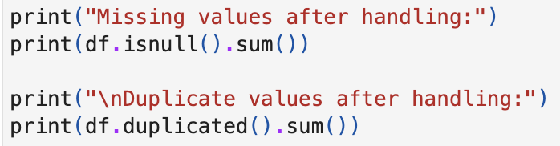
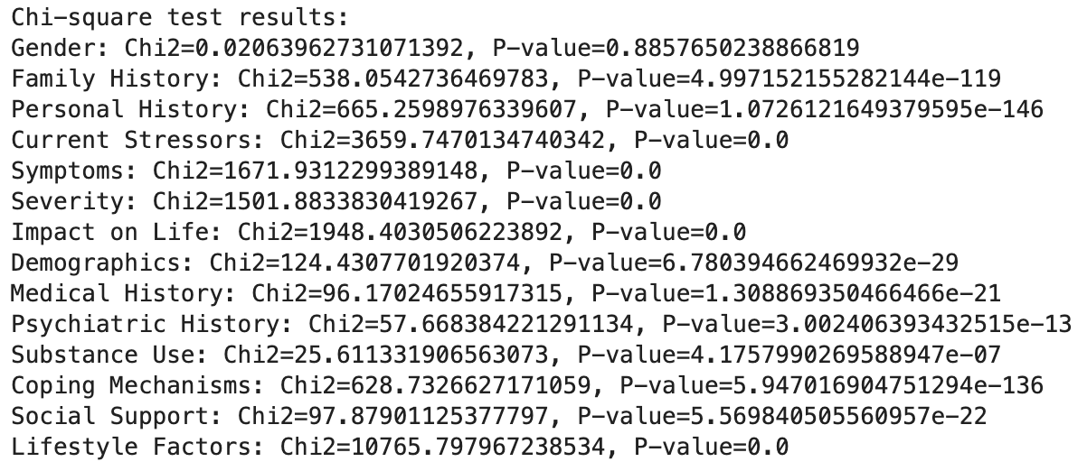
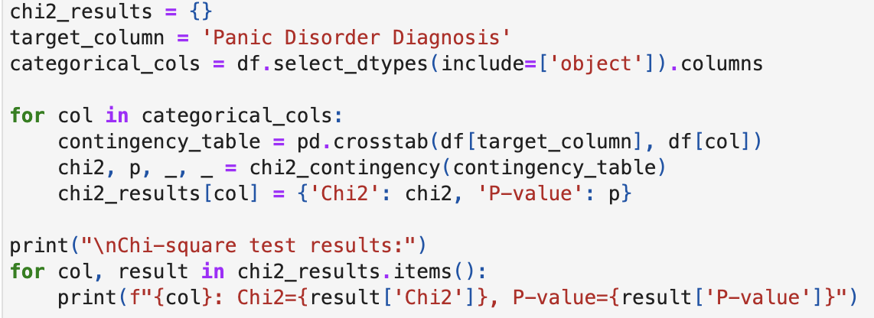
Dealing with missing and duplicate values
Chi Square Test

Slide 8
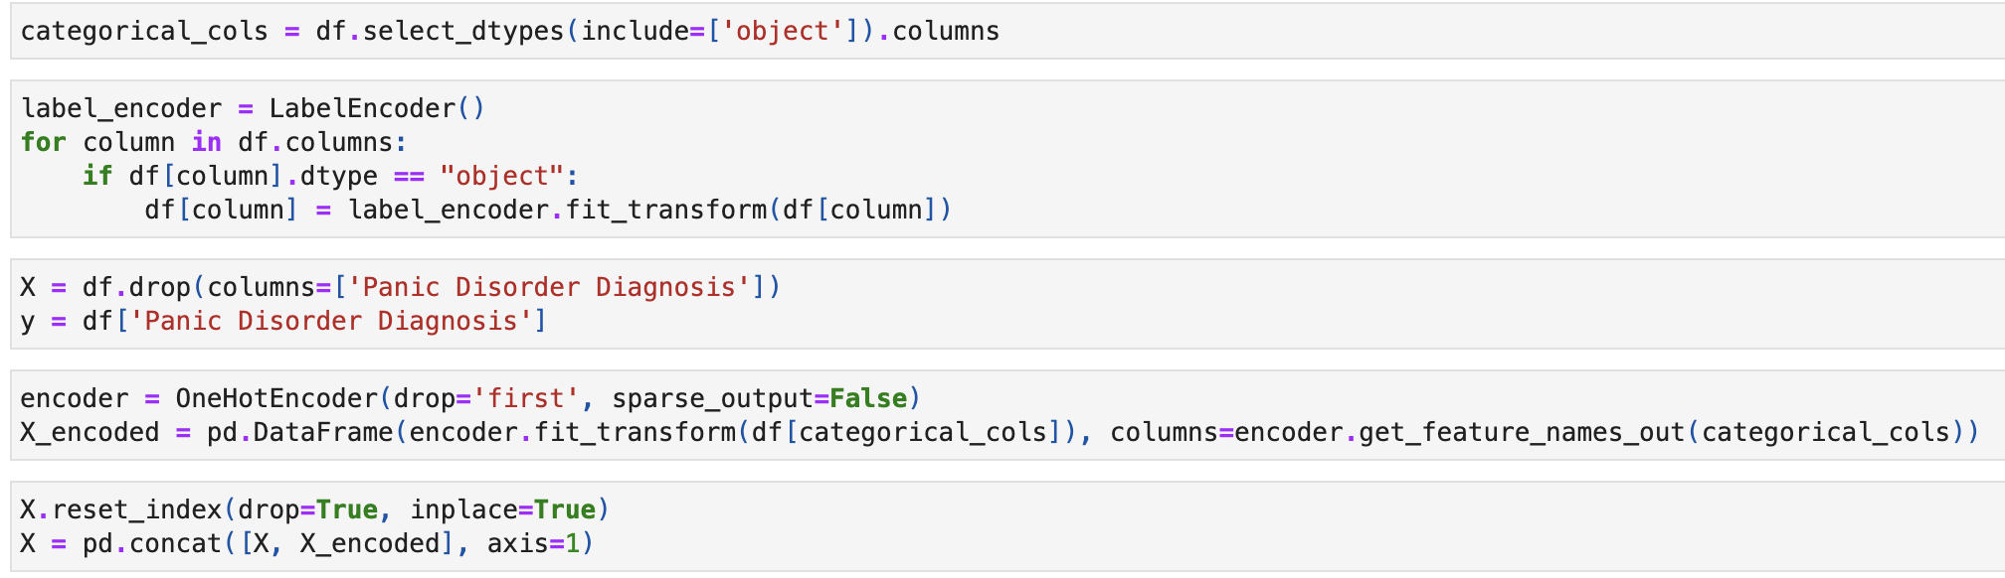
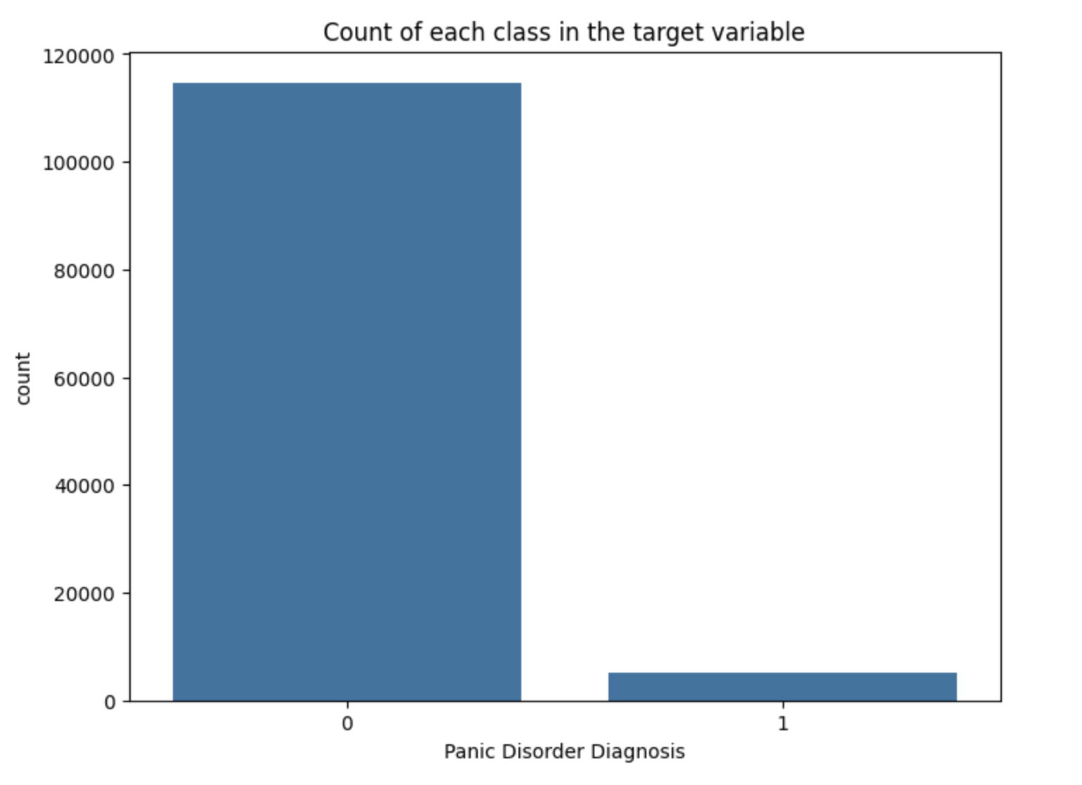
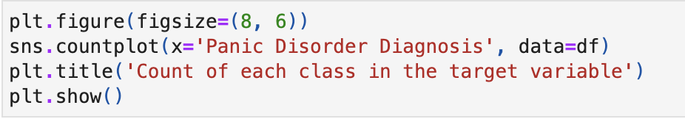
Removing the insignificant columns
Encoding the categorical columns
Data Visualisation

Slide 9
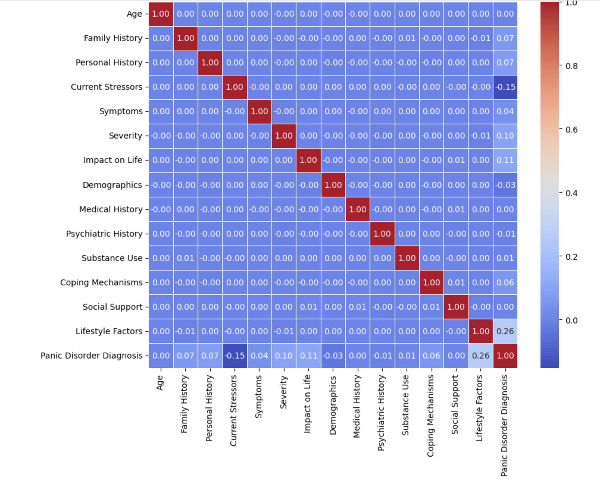
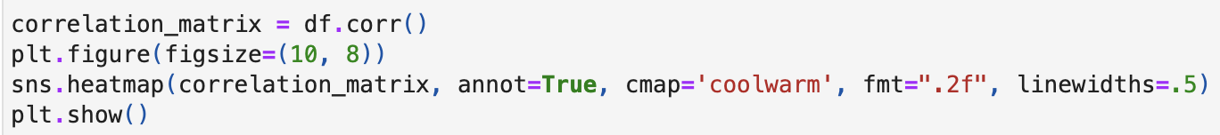
Correlation Matrix

Slide 10
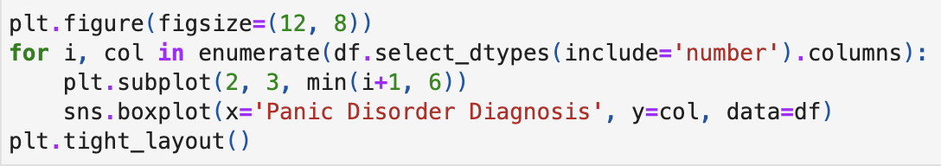
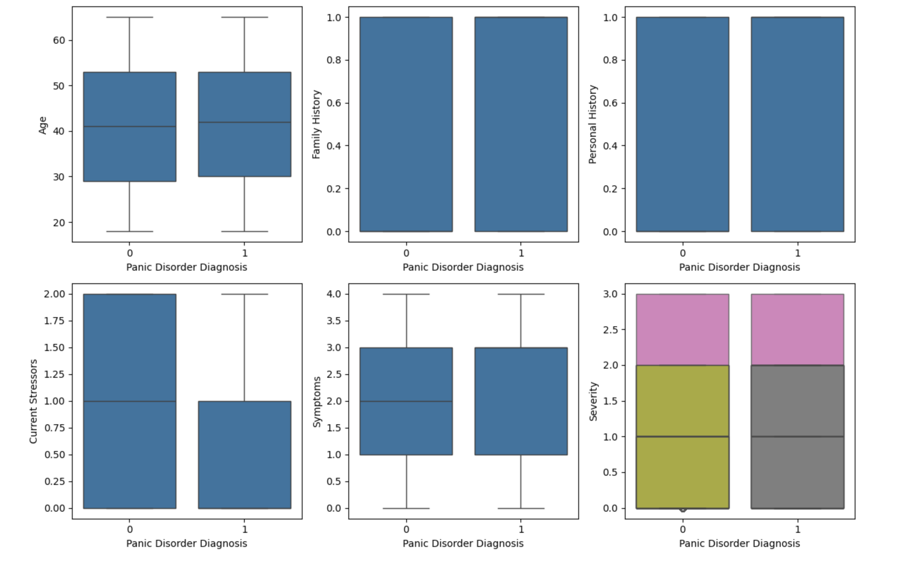
Box Plot

Slide 11
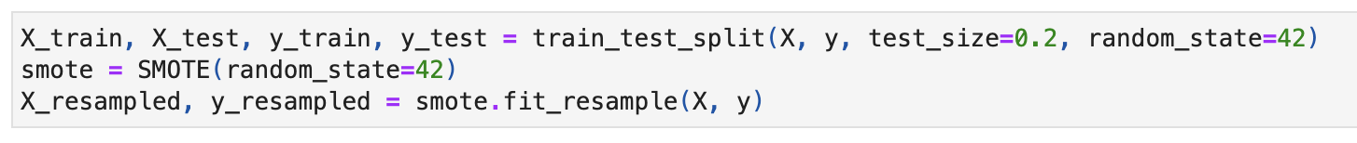
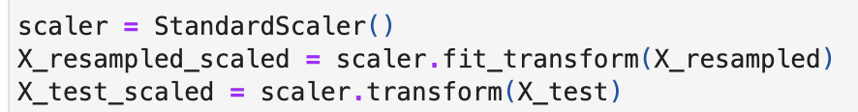
Dealing with unbalanced data
Scaling the data

Slide 12
Machine Learning Models
Import necessary libraries
Create the model
Train the model on the training set
Make predictions on the testing set
Evaluate the performance of the model

Slide 13
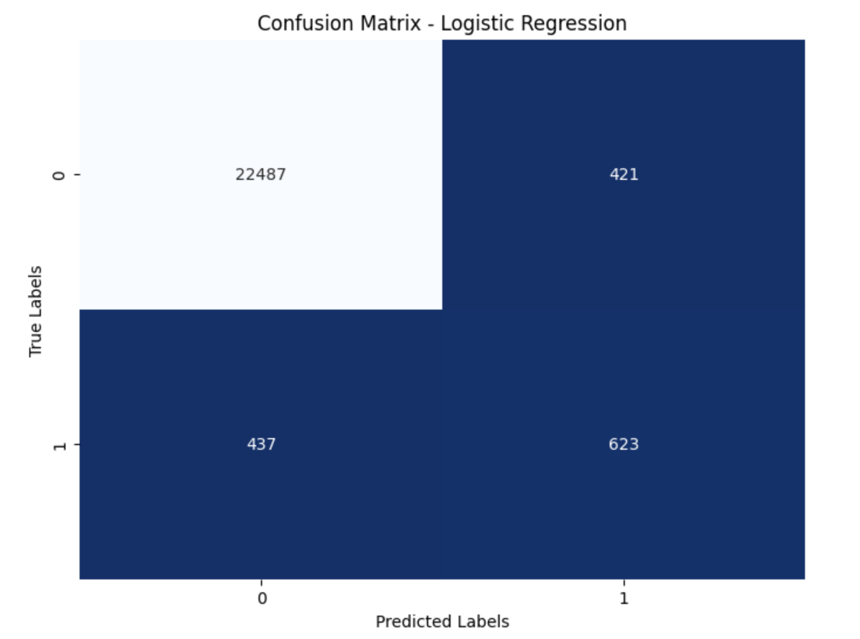
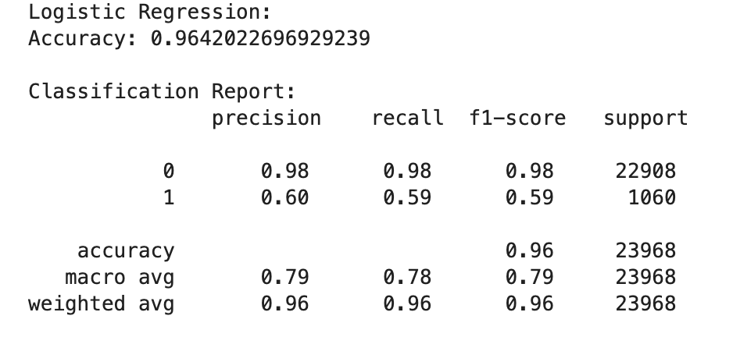
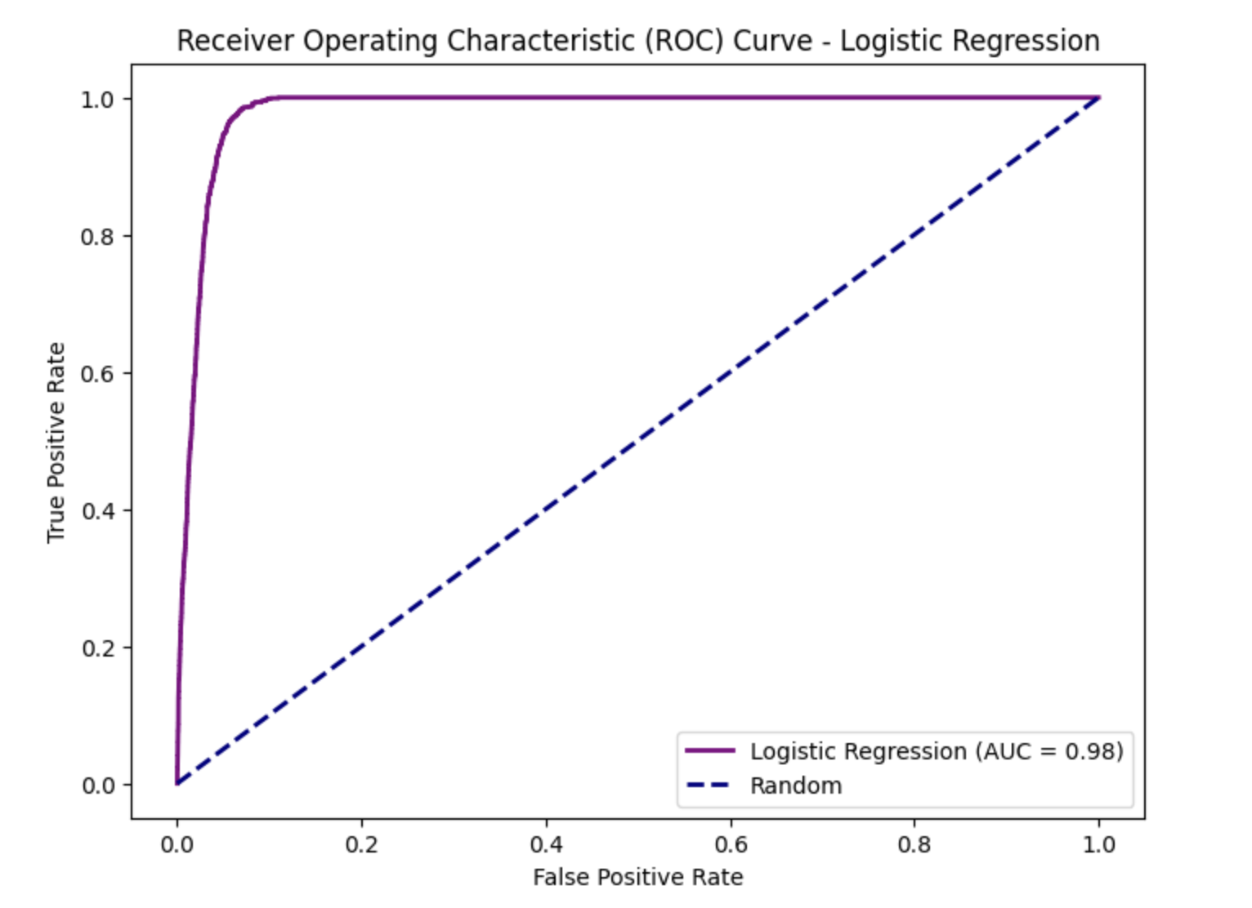
Logistic Regression
Accuracy: 96.42%
Precision: 60%
Recall: 59%
F1-score: 59%
Confusion Matrix: TP=623, TN=22487, FP=421, FN=437

Slide 14
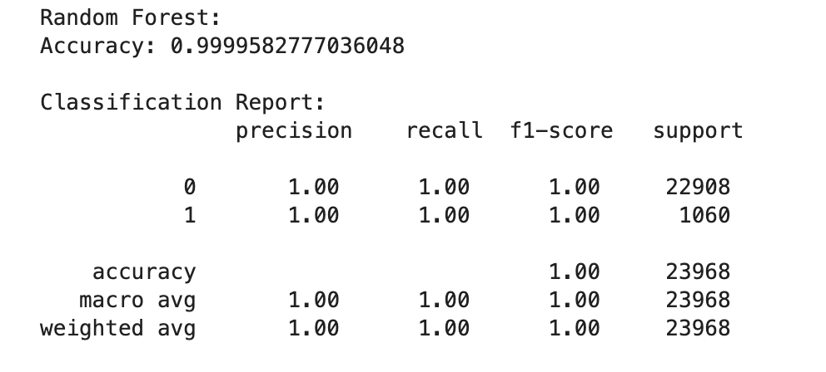
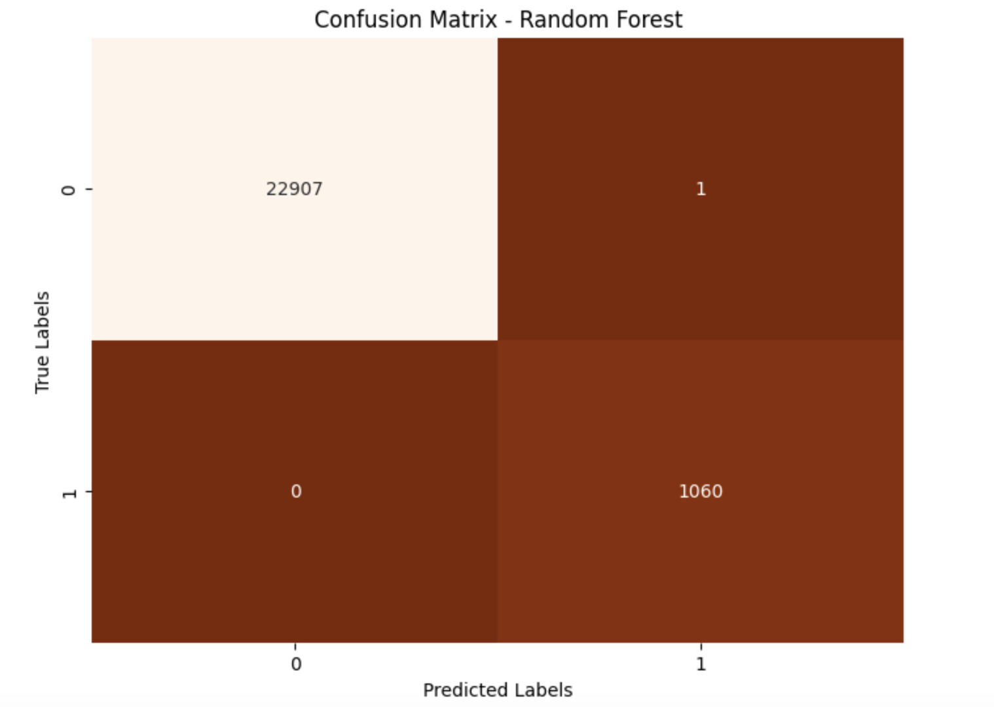
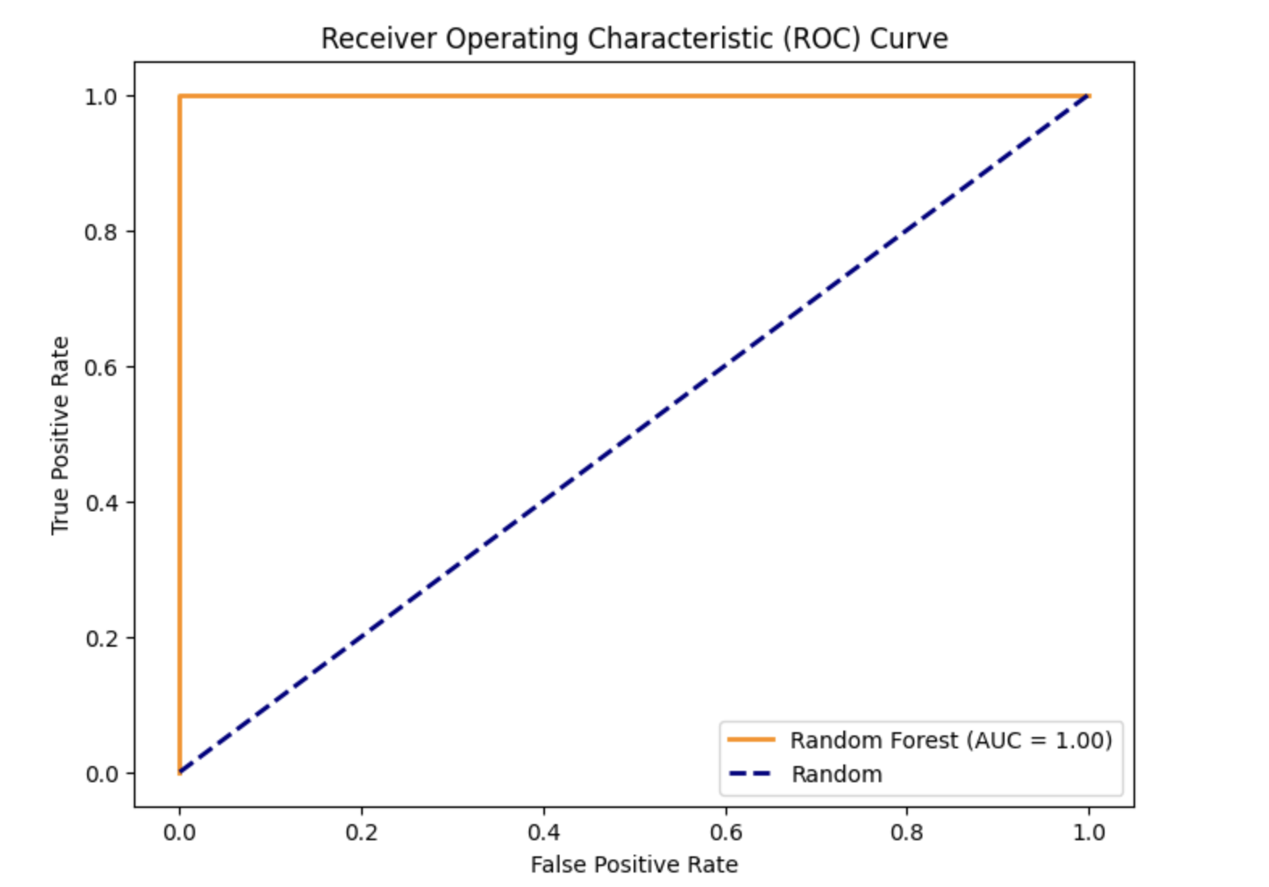
RandomForestClassifier
Accuracy: 99.99%
Precision, Recall, F1-score: 100%
Confusion Matrix: TP=1060, TN=22907, FP=1, FN=0

Slide 15
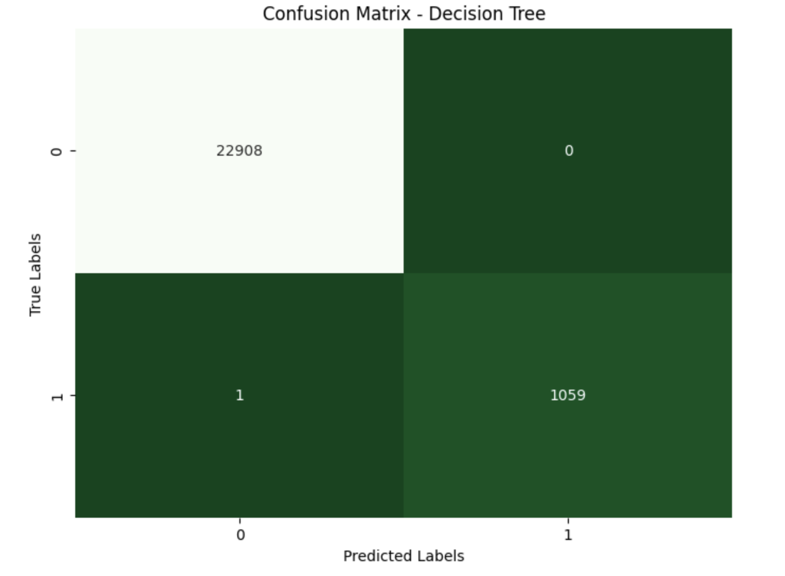
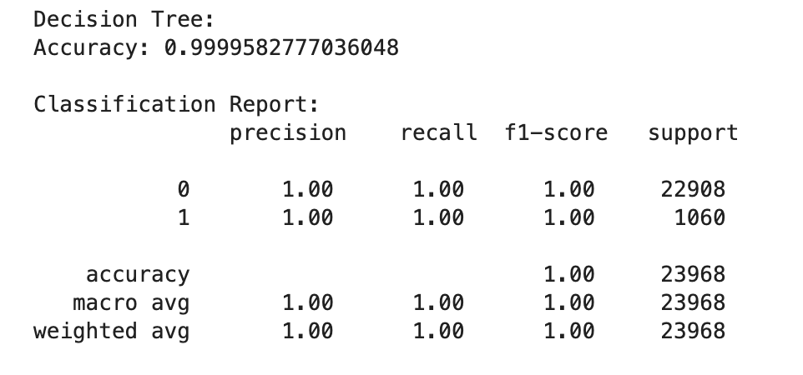
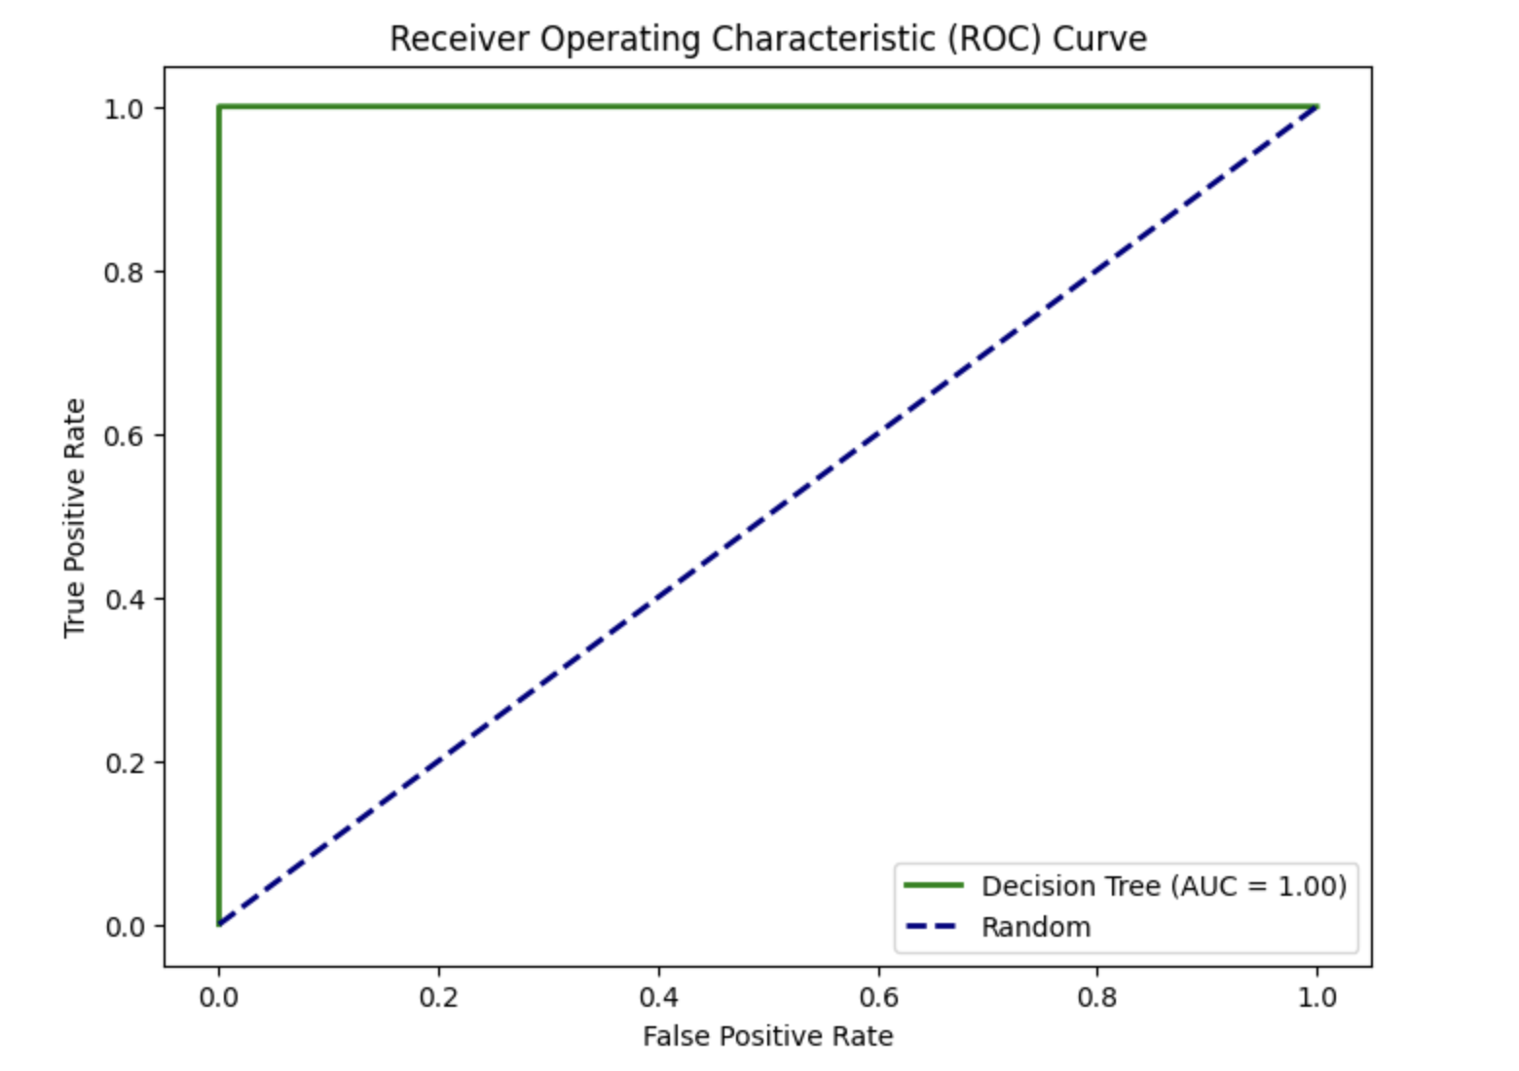
Decision Tree
Accuracy: 99.99%
Precision, Recall, F1-score: 100%
Confusion Matrix: TP=1059, TN=22908, FP=0, FN=1

Slide 16
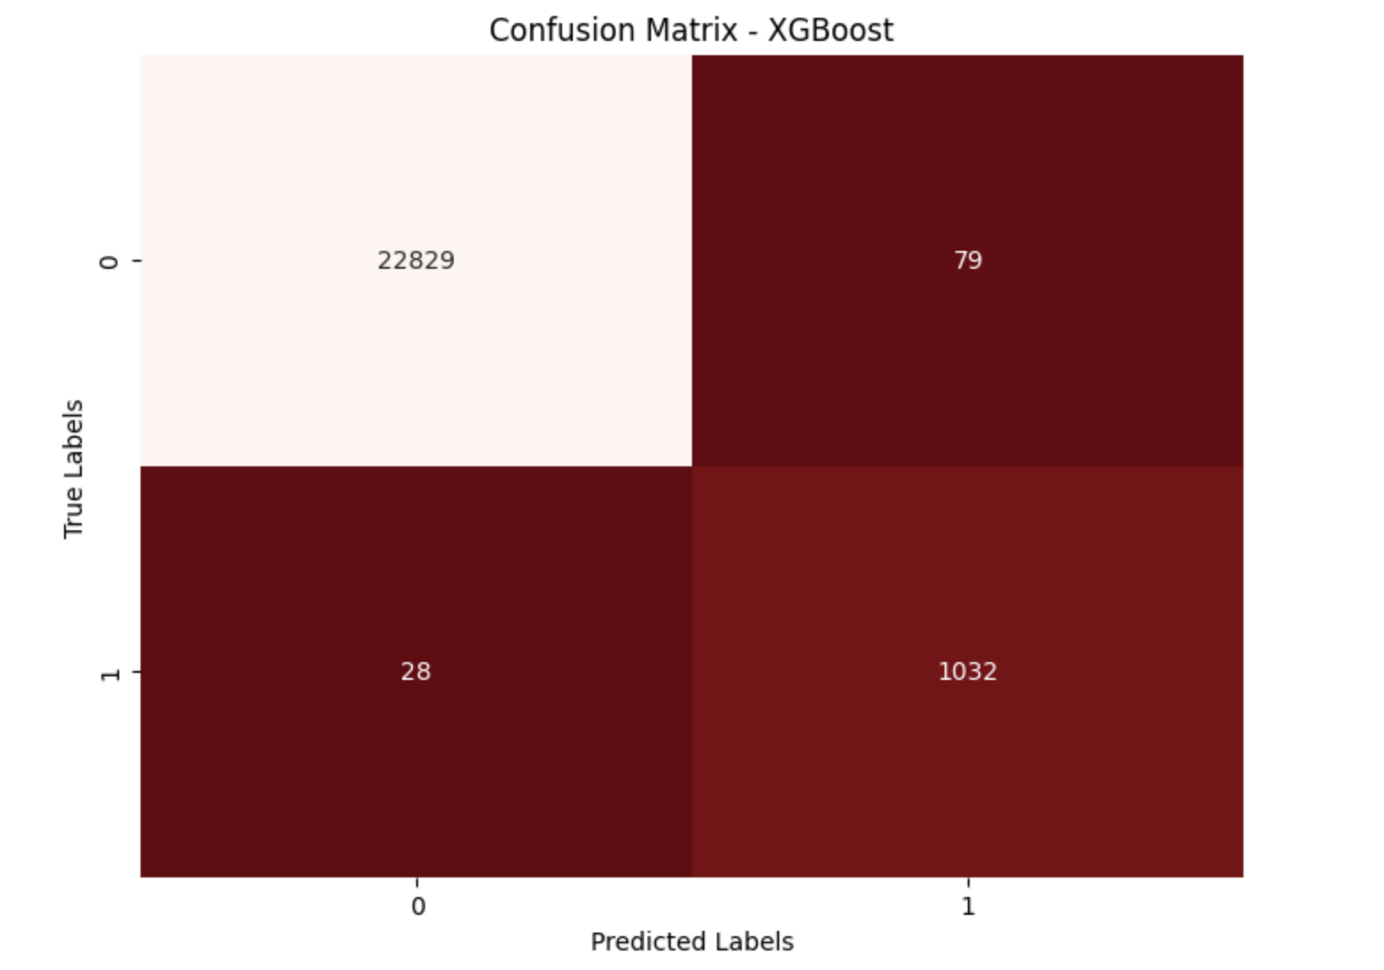
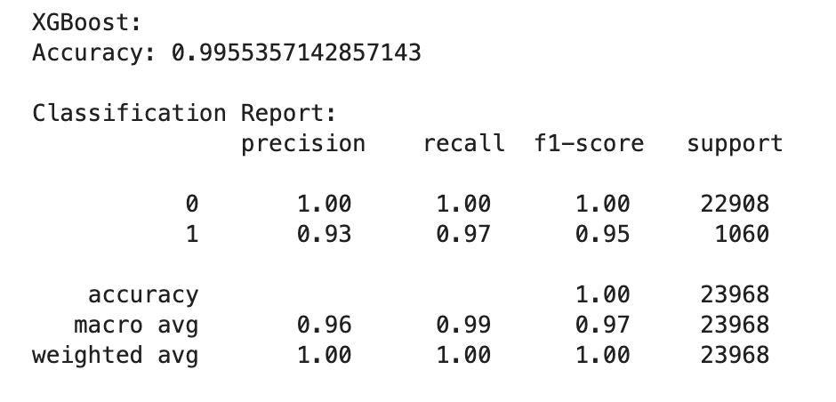
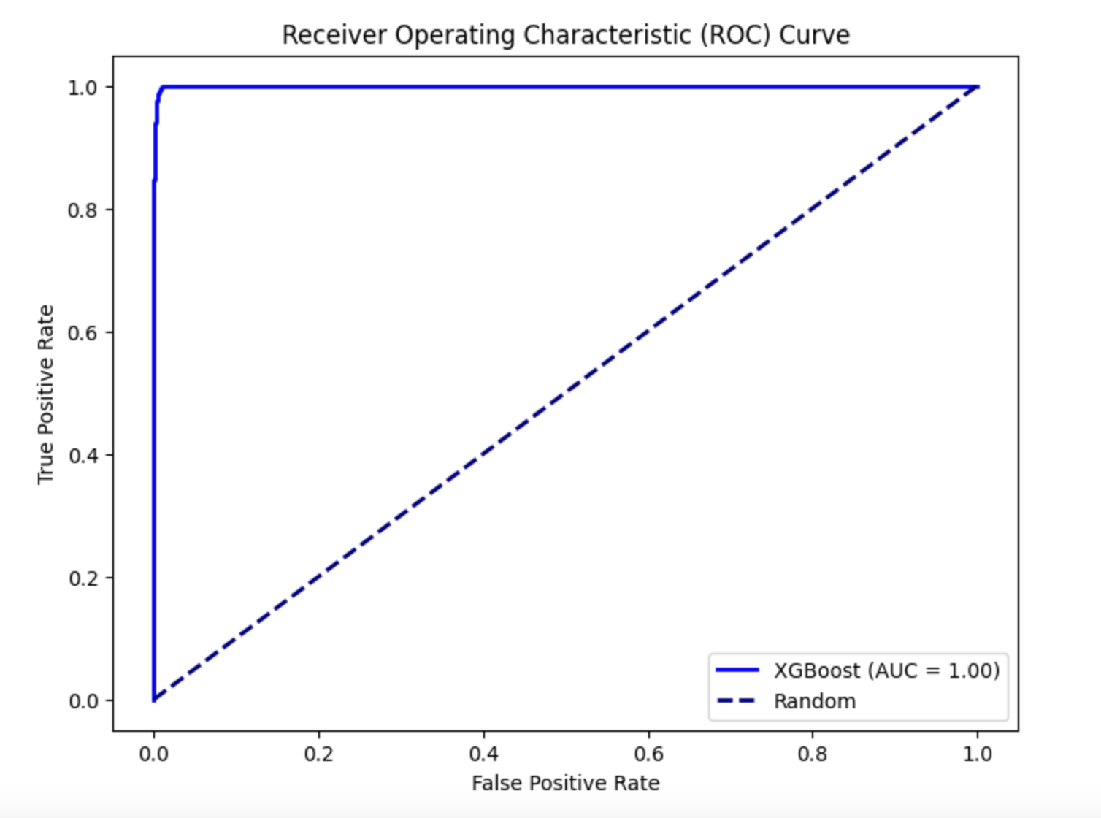
XGBooster
Accuracy: 99.55%
Precision: 93%
Recall: 97%
F1-score: 95%
Confusion Matrix: TP=1032, TN=22829, FP=79, FN=28

Slide 17
Conclusion
All models performed exceptionally well, but Random Forest and Decision Tree achieved perfect accuracy.
Random Forest and Decision Tree models are overfitting the data as indicated by their high accuracy and perfect precision, recall, and F1-score.
Logistic Regression, while having a lower accuracy, provides a more balanced view with reasonable precision, recall, and F1-score.
Consideration should be given to the trade-off between model complexity and interpretability.
Further fine-tuning and validation on an independent dataset may be necessary to confirm the robustness of the models.
Notes:
The choice of the best model depends on the specific goals and constraints of the project. If interpretability is crucial, Logistic Regression may be preferred, but if maximizing accuracy is the primary goal, Random Forest and Decision Tree models could be considered. It's essential to validate these models on new data to ensure their generalization performance.

Slide 18
Hypothesis
Reject the null hypothesis as all the factors expect gender has a significant impact on Panic Disorder Diagnosis.
Based on the p values the factors which are highly risky for Panic Disorder are-
Current Stressors
Severity
Impact on Life
Symptoms
Lifestyle Factors

Slide 19
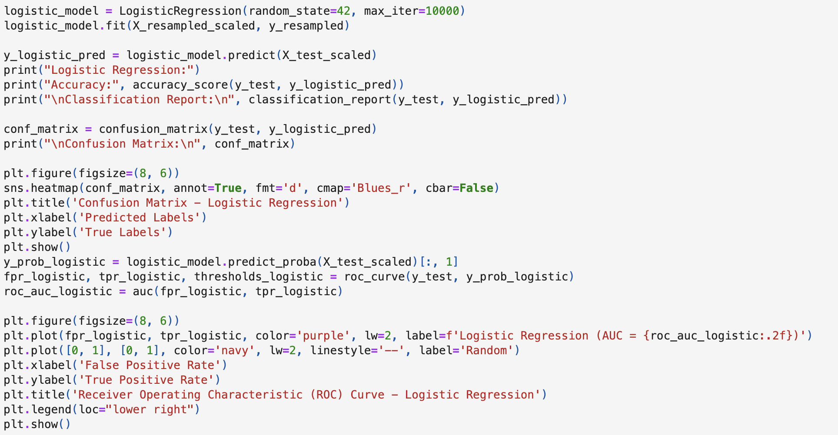
Appendix (Codes for model, confusion matrix and ROC curve)

Slide 20
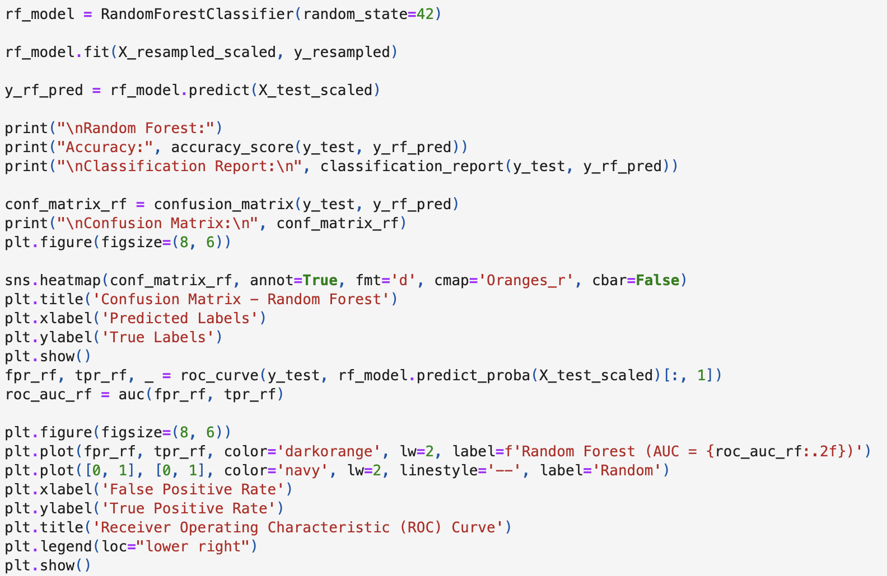
Appendix (Codes for model, confusion matrix and ROC curve)-2

Slide 21
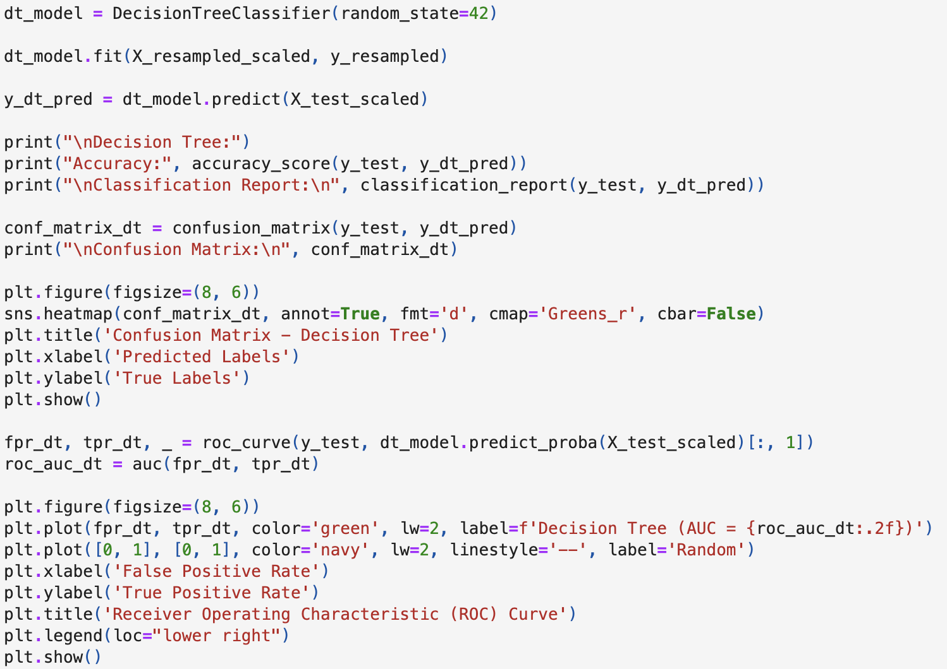
Appendix (Codes for model, confusion matrix and ROC curve)-3

Slide 22
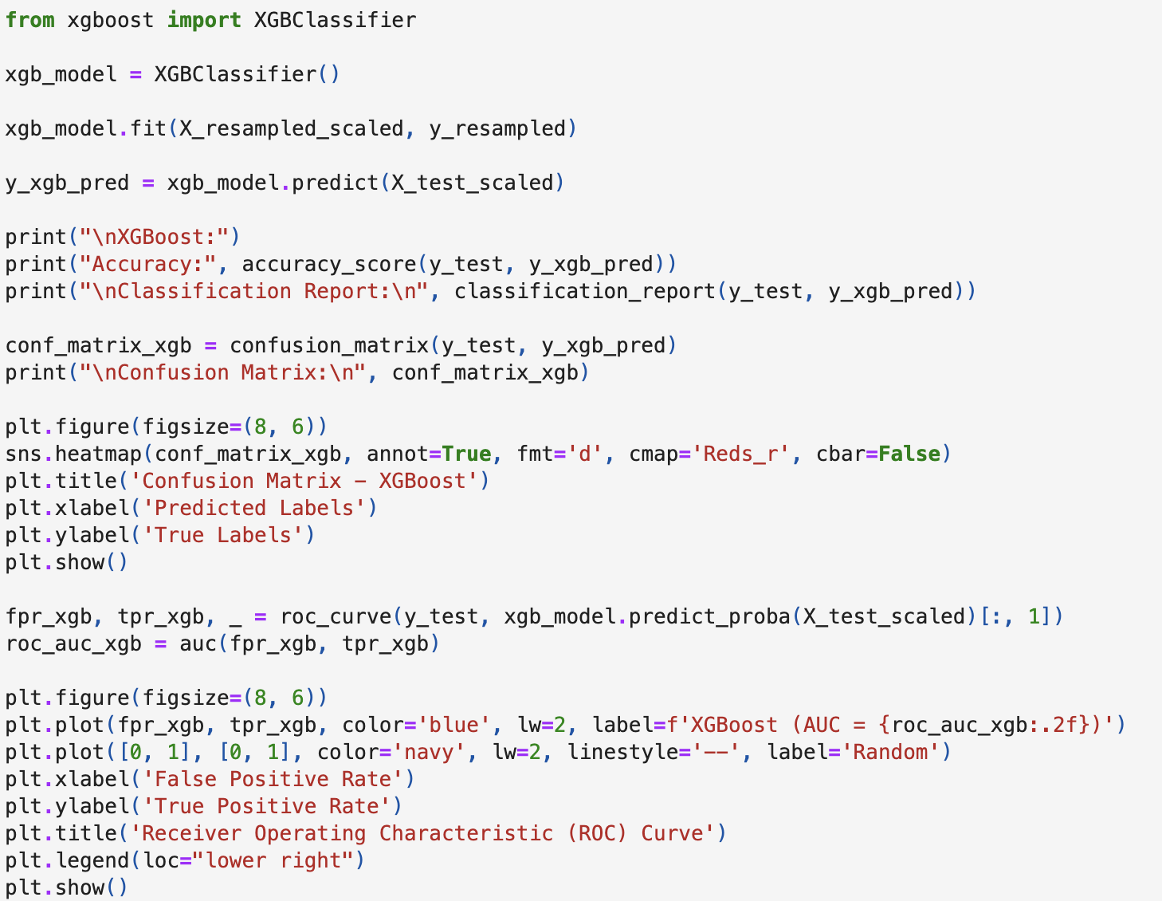
Appendix (Codes for model, confusion matrix and ROC curve)-4

Slide 23
Thank You ☺

